Slide 1


GPS Trails
Alekh Meka, Ayaan Siddiqui, Karan Vishwakarma, Maseeh Khan

Slide 2
Contents
Background
Objectives and Goals
Problem Statement
Scope of Project
Walkthrough of Product

Slide 3
Background
Centralized Database of Trails
Web Application/Mobile Use
Review System
User-ended Add-A-Trail feature
Angular Front-End, Node JS with MySQL DB

Slide 4
Objectives and Goals
Increased Inflow of Trail Visitation
Generate a social network relevant to the hiking community
Short-term – Raise awareness of trails, foster a new community
Long-term - Provide donations for deforestation prevention and environmental aid

Slide 5
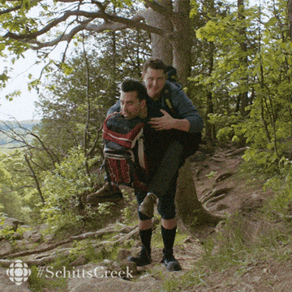
Problem statement
Trailing of parks is difficult with so many terrains.
Honest reviews from users for clear image of the places.
Exact paths for trails.

Slide 6
scope
Explorers and Adventure seeking people
National parks authorities.
Families with small children in hiking.
Academic groups.

Slide 7

walkthrough
GPS Trails is based on the client server architecture.
Explore
Add Trials
Park sub trails section
Home

Slide 8
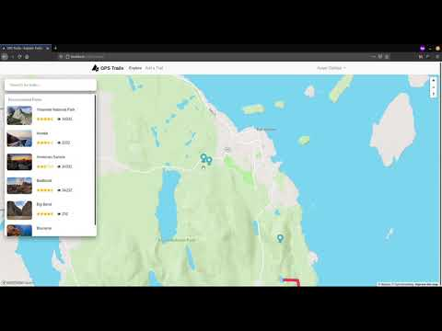

Slide 9

cONCLUSION
Thank you

